Slide 1
Unit: Organic Materials: Structure & Function
Subject Matter:
appreciate that organic materials including proteins, carbohydrates, lipids and synthetic polymers display properties including strength, density and biodegradability that can be explained by considering the primary, secondary and tertiary structures of the materials
describe and explain the primary, secondary (α-helix and β-pleated sheets), tertiary and quaternary structure of proteins
recognise that enzymes are proteins and describe the characteristics of biological catalysts (enzymes) including that activity depends on the structure and the specificity of the enzyme action
recognise that monosaccharides contain either an aldehyde group (aldose) or a ketone group (ketose) and several -OH groups, and have the empirical formula CH₂O
distinguish between α-glucose and β-glucose, and compare and explain the structural properties of starch (amylose and amylopectin) and cellulose
recognise that triglycerides (lipids) are esters and describe the difference in structure between saturated and unsaturated fatty acids
describe, using equations, the base hydrolysis (saponification) of fats (triglycerides) to produce glycerol and its long chain fatty acid salt (soap), and explain how their cleaning action and solubility in hard water is related to their chemical structure
explain how the properties of polymers depends on their structural features including; the degree of branching in polyethene (LDPE and HDPE), the position of the methyl group in polypropene (syntactic, isotactic and atactic) and polytetrafluorethene.

Slide 2
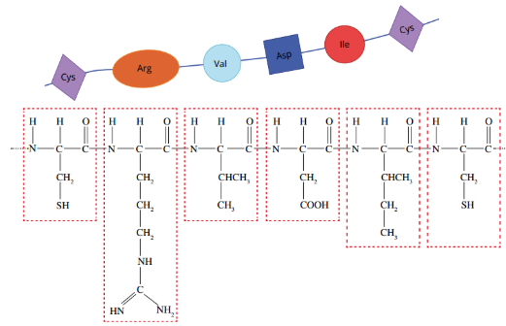
describe and explain the primary, secondary (α-helix and β-pleated sheets), tertiary and quaternary structure of proteins
Primary Structure of a protein.
Proteins are long chain molecules (polymers) composed of amino acids (monomers)
Amino acids are covalently joined via peptide bonds
The order of the amino acid sequence is called the primary structure and determines the way the chain will fold.
Different amino acid sequences will fold into different configurations due to the chemical properties of the variable side chains.

Slide 3
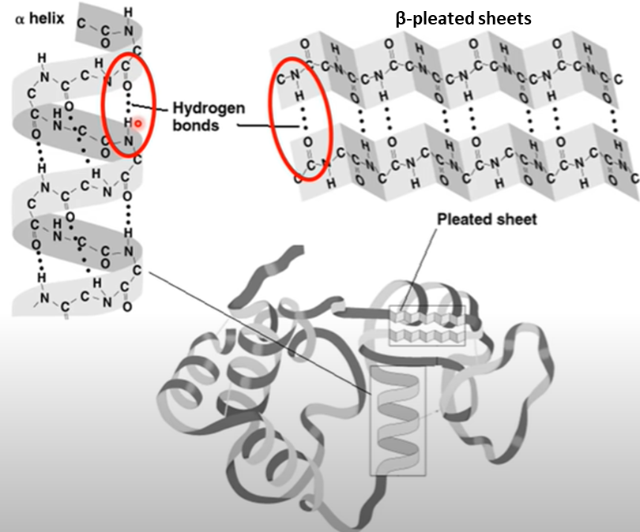
describe and explain the primary, secondary (α-helix and β-pleated sheets), tertiary and quaternary structure of proteins
Secondary Structure of a protein.
The secondary structure of a protein refers to the folding of the polypeptide chain as a result of hydrogen bonding forming between non-adjacent amino (-NH₂) and carboxyl groups (-COOH)
Alpha helices occur when the amino acid sequence folds into a coil / spiral arrangement
Elastic
The H-bonds are easily broken and allows the molecule to stretch.
Beta-pleated sheets occur when the amino acid sequence adopts a directionally-oriented.
Inelastic
Inter-chain H-bonding creates cross-links, which are stronger than intra-chain H-bonds and not easily broken.

Slide 4
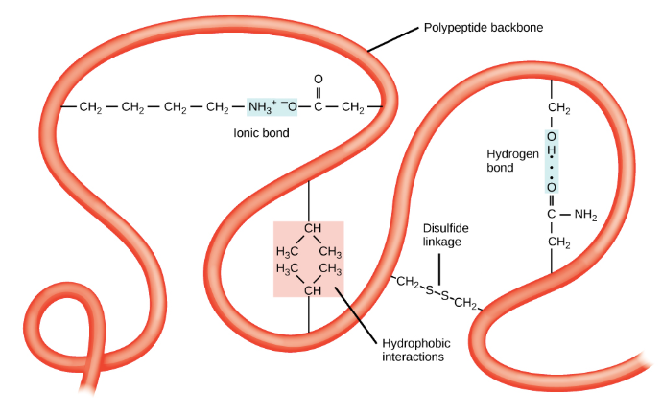
describe and explain the primary, secondary (α-helix and β-pleated sheets), tertiary and quaternary structure of proteins
Tertiary Structure of a protein.
The overall three-dimensional configuration of the protein is referred to as the tertiary structure of the protein.
The tertiary structure of a polypeptide chain will be determined by the interactions between the variable side chains
These interactions may include hydrogen bonds, disulphide bridges, ionic interactions, London (dispersion) force.
Note: the order of the amino acid sequence (primary structure) determines all subsequent levels of protein folding

Slide 5
describe and explain the primary, secondary (α-helix and β-pleated sheets), tertiary and quaternary structure of proteins
Tertiary Structure of a protein.
Hydrophobic side-chains tend to fold inwards to the interior of the protein molecule where they are shielded from the aqueous medium and can interact with each other.
The formation of disulfide bridges is an important aspect of the stabilisation of protein tertiary structure, allowing different parts of the protein chain to be held together covalently.
Hydrogen bonds may form between different side-chain groups and can bring together two parts of a chain that are some distance away in terms of sequence of amino acids.
Electrostatic forces between positively and negatively charged sites on amino acid side-chains also help to stabilise the tertiary structure of a protein.

Slide 6
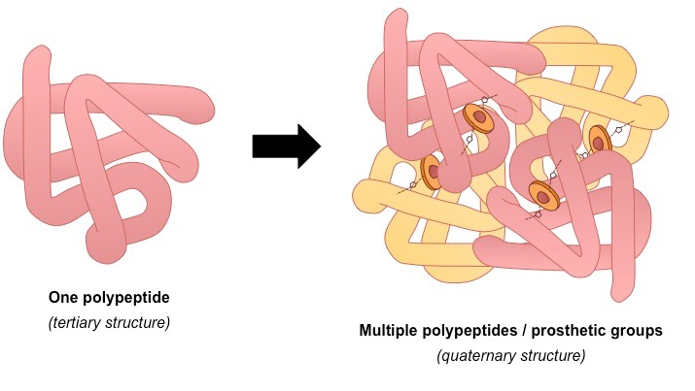
describe and explain the primary, secondary (α-helix and β-pleated sheets), tertiary and quaternary structure of proteins
Quaternary Structure of a protein.
Quaternary structures are found in proteins that consist of more than one polypeptide chain linked together

Slide 7
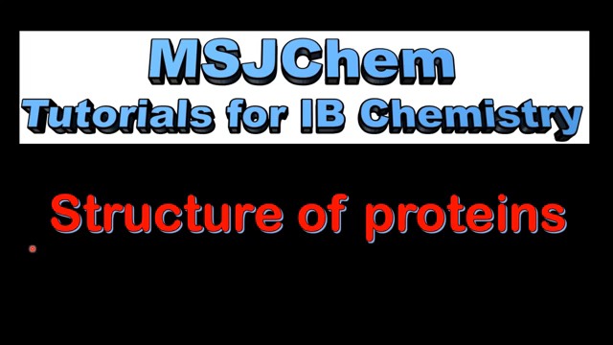
Summary of Proteins

Slide 8
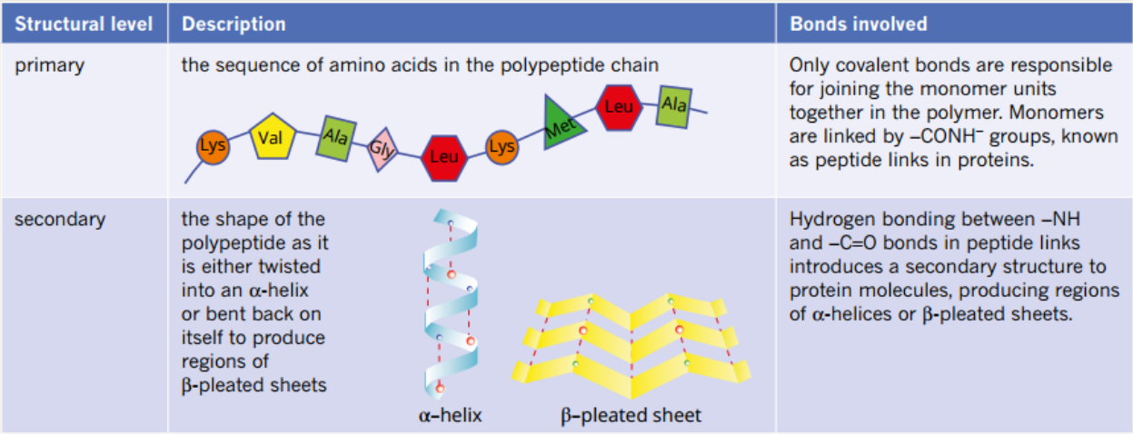
Summary of Proteins

Slide 9
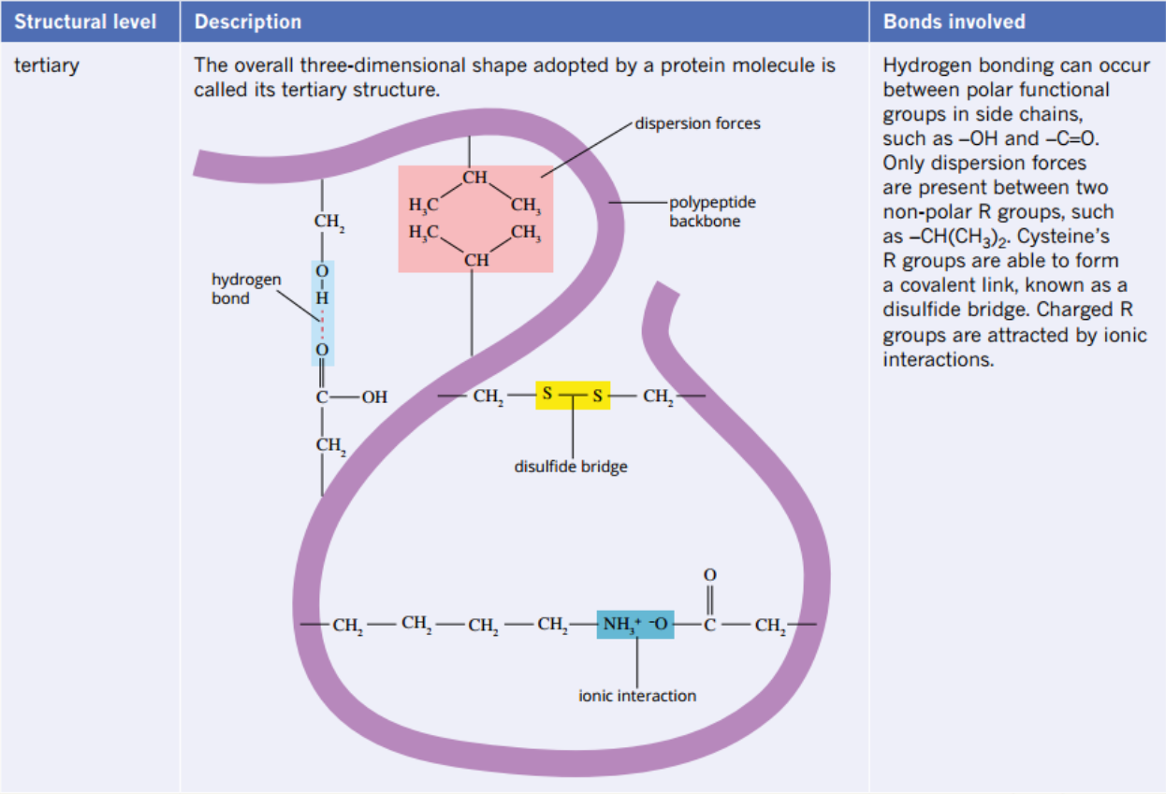
Summary of Proteins

Slide 10
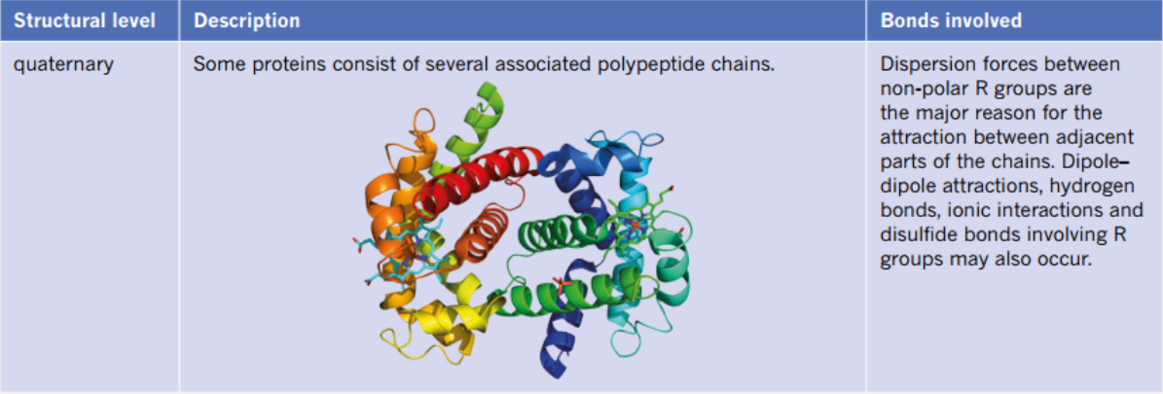
Summary of Proteins

Slide 11
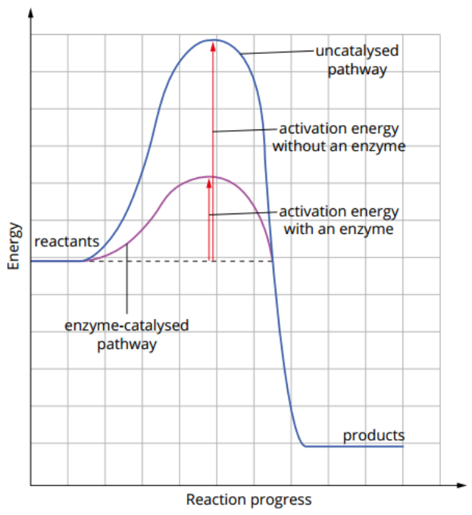
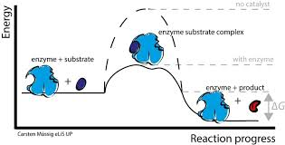
recognise that enzymes are proteins and describe the characteristics of biological catalysts (enzymes) including that activity depends on the structure and the specificity of the enzyme action
Enzymes.
Enzymes are proteins that function as biological catalysts
They form an enzyme–substrate complex that lowers the activation energy by providing an alternative pathway for the reaction of substrate to product.

Slide 12
Characteristics of Biological enzyme catalyst
recognise that enzymes are proteins and describe the characteristics of biological catalysts (enzymes) including that activity depends on the structure and the specificity of the enzyme action
Enzymes increase the rate of reaction by lowering the activation energy providing alternative pathway
Enzymes are not used up or altered in the reaction and therefore can be used again
The catalytic action of enzymes is specific for a single reaction or type of reaction.
The action of the enzyme depends on its specific 3D structure.
Enzymes are sensitive to reaction conditions, pH and temperature if denatured or shape altered they are rendered ineffective.
H+ from acid and an increase in temperature can break hydrogen bonding.

Slide 13
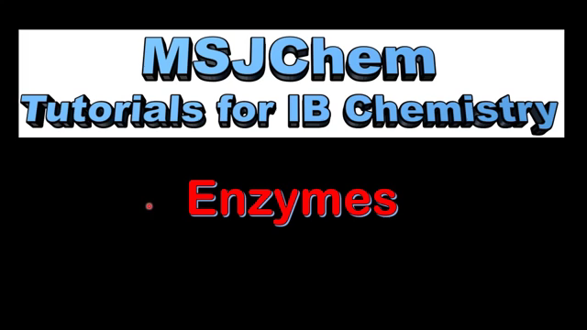

Slide 14
WORKSHEET

